Slide 1


Welcome
To
MS Excel

Slide 2



Introduction
MS Office is an Application software developed by Microsoft corporation USA . Microsoft was founded by Bill Gates and Paul Allen on April 4, 1975,
Microsoft Corporation, leading developer of personal-computer software systems and applications.
MS Office is mainly used for office work such as
Documentation
Worksheet
Presentation
Database

Slide 3
MS Excel
MS Excel is a commonly used Microsoft Office application developed and published by Microsoft Corporation. It is a spreadsheet program, where one can record data in the form of tables. Excel organizes data in columns and rows . This gives the user a more systematic display of data.
USEs Of MS Excel
Business Analysis. ...
People Management. ...
Managing Operations. ...
Performance Reporting. ...
Office Administration. ...
Strategic Analysis. ...
Project Management. ...
Managing Programs.

Slide 4
How to Open MS Excel
Start → All Programs → MS Office → MS Excel.
Start → Run→ Type ( Excel )→ Enter
Double Click on MS Excel Icon on desktop
Note: .XLS Is the file extension, when we save the along with file name automatically gets file extension

Slide 5
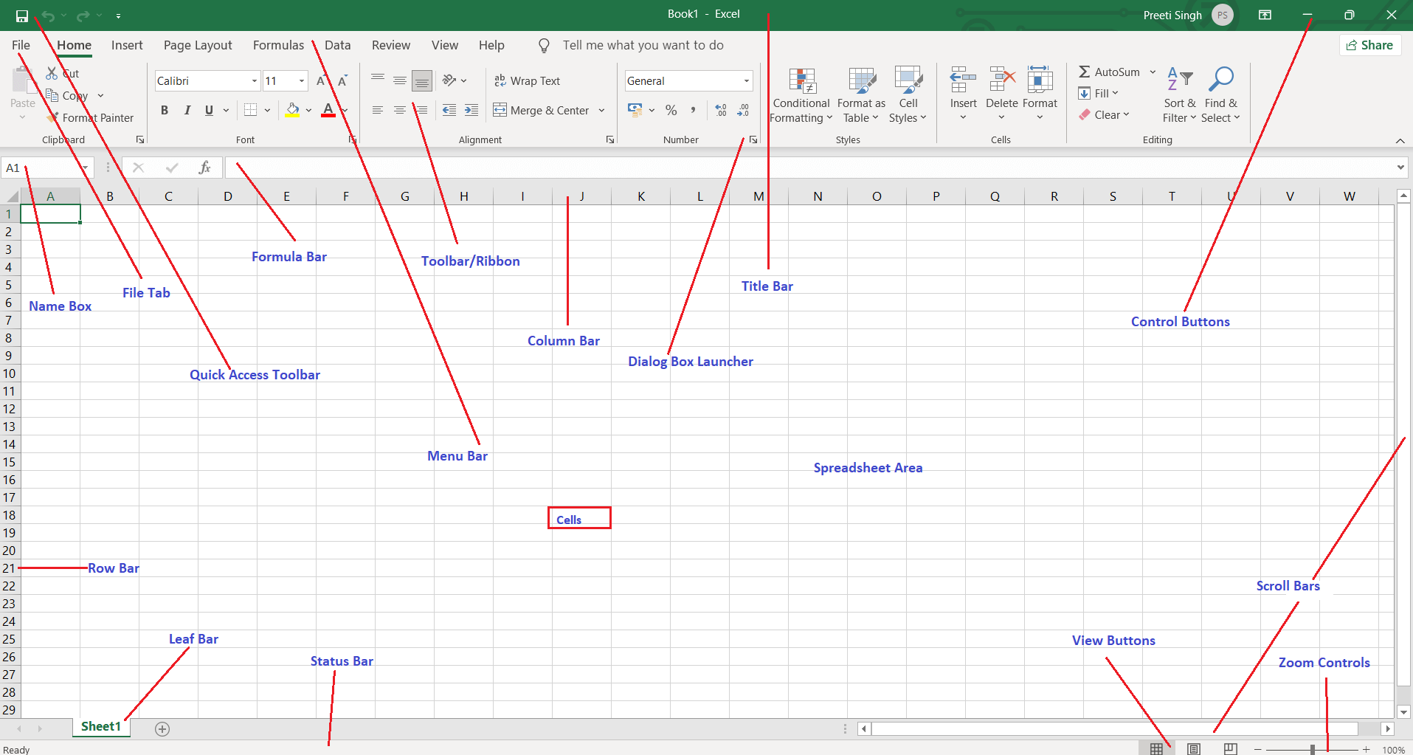
Window Screen

Slide 6
Title Bar :I It Displays the title of the document
Tabs : Excel consist of pre define sets of Tabs like : Home, Insert, Pagelayout, Formula, Data, Revie, View
Ribbon : Ribbon are the bar present in below the tab bar, when you click on each tab all options will present
Name Box : Name box will be identify the address of the each cell
The formula bar in Excel is located next to the name box and above the worksheet area. It displays the data stored in the active cell
Columns :Horizontal Alphabets in each headers are called columns. ( Total Number of columns-16384 ) like A,B, C, ……. Z, AA, AB….XFD)
Rows : Vertical numbers in each headers are called Rows (Total Columns are 1048576 ) 1-1048576

Slide 7
Cell: Intersections of Columns and Rows are called a Cell
Active cell is the selected cell in which data is entered when you begin typing
A cell reference is the set of coordinates that a cell occupies on a worksheet. It identifies the location of a cell in the spreadsheet
Data is information that is stored in a spreadsheet. Data is stored in the individual cells of a worksheet.
The formula bar in Excel is located next to the name box and above the worksheet area. It displays the data stored in the active cell
A function is a prewritten formula. A function takes a value (or values), performs an operation, and returns a new value (or values.)
Sheet Tab: Sheet tabs are the pre define sheets available in the down left side of the excel window
Shift F11 is the short cut key to insert new sheet
Date : Ctrl + ;
Time : Ctrl + Shift + ; Date and Time : =now()

Slide 8
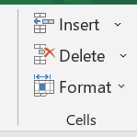
How To Delete a Columns or Row :
1. Select the column or Row to be delete
2. Got to Home tab
3. Select Delete option from Cell Group
Or
Select the place from Column or Row where you want to delete and press shortcut key Ctrl -
How To Insert New Columns or Row :
1. Select the column or Row to be insert
2. Got to Home tab
3. Select Insert option from Cell Group
Or
Select the place from Column or Row where you want to insert and press shortcut key Ctrl +

Slide 9
How To Hide Column & Rows
Hide a column: Select a cell in the column to hide, then press Ctrl + 0. ...
Hide a row: Select a cell in the row you want to hide, then press Ctrl + 9. ...
How To Unhide Column & Rows
Unhide a column: Select a cell in the column to hide, then press Ctrl + Shift +0.
Unhide a row: Select a cell in the row you want to hide, then press Ctrl + shift + 9. .
Or
You can use Home tab Format option from cell group

Slide 10
How Change Row Height and Column width
Go to Home tab
Select Format option from Cell group
Do what you want to made like Row height or Column width
Or
You can use Home tab Format option from cell group to change row height and column width

Slide 11
IF function
IF function are preprogrammed Formula in Excel and it evaluates whether a given condition is met and returns a value depending on whether the result is “true” or “false”. It is a conditional function of Excel, which returns the result based on the fulfillment or non-fulfillment of the given criteria.
The IF excel function accepts the following arguments:
Logical_test: It refers to the condition to be evaluated. The condition can be a value or a logical expression.
Value_if_true: It is the value returned as a result when the condition is “true”.
Value_if_false: It is the value returned as a result when the condition is “false”.

Slide 12
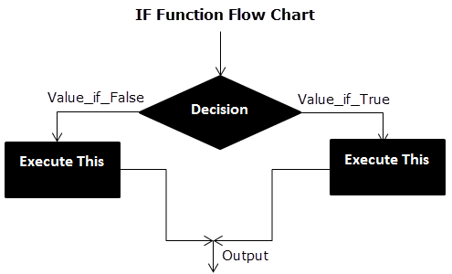
Flow Chart of Generic IF Excel Function

Slide 13
Example Of IF Function
Eligible for Vote or Not
Name | Age | Remarks
AAA | 20 | Eligible
BBB | 18 | Eligible
CCC | 16 | Not Eligible
DDD | 20 | Eligible
EEE | 17 | Not Eligible
Remarks=IF(B4>=18,"Eligible","Not Eligible")

Slide 14
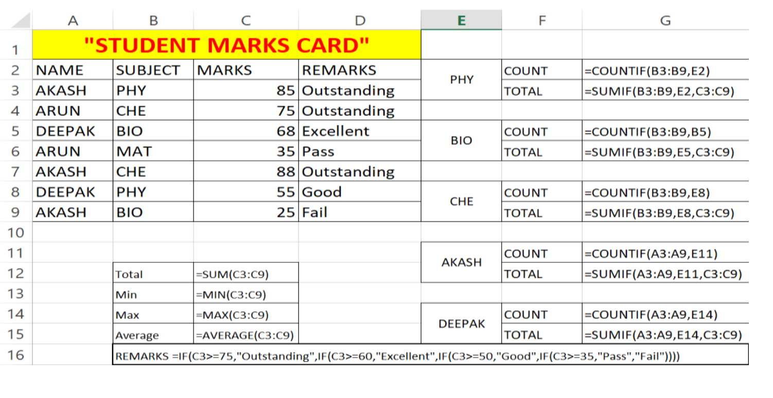
We apply the Nested IF in Excel since we have multiple criteria to find and decide each student’s grade.

Slide 15
What is Chart
Chart is a pictorial representation of a data which we can identify the values of data easily .
Major Chart types
Column chart
Pie chart
Bar Chart
Line Chat
Bubble Chart
Area Chart

Slide 16
How To Insert Chart
1. Select entire data from the sheet
2. Go to Insert Tab
3. Select any one chart from Chart Group
Or
Use Short Cut Key F11 – to insert new Chart Sheet .

Slide 17
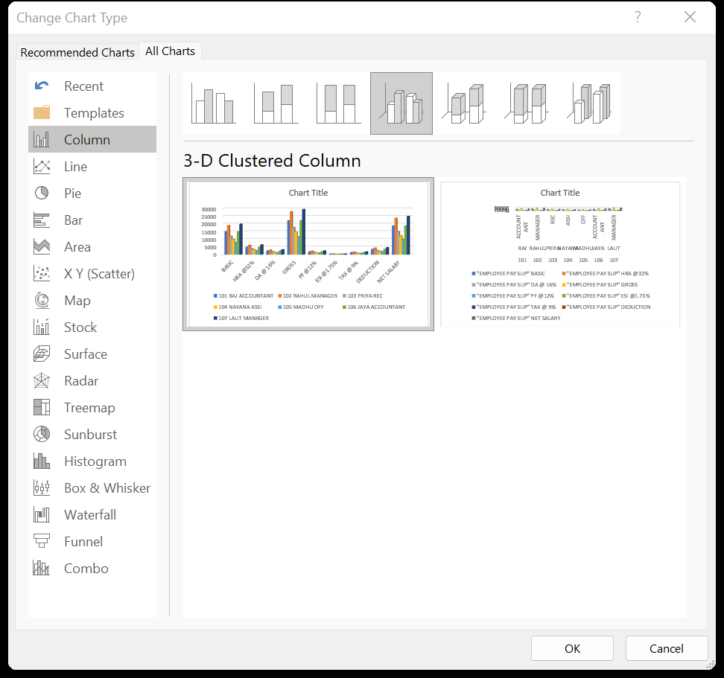

Slide 18
Chart elements
Axes
Axis titles
Chart titles
Data labels
Data table
Error bars
Gridlines
Legend
Trendline

Slide 19
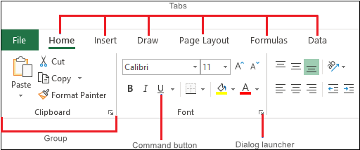
Tabs

Slide 20
Tabs
File: It allows you to jump into the backstage view that contains the essential file-related commands and Excel options.
Home: It contains the most frequently used commands such as copying and pasting, sorting and filtering, formatting, etc.
Insert: It is used for adding different objects in a worksheet such as images, charts, PivotTables, hyperlinks, special symbols, equations, headers, and footers.
Page Layout: It provides tools to manage the worksheet appearance, both onscreen and printed. These tools control theme settings, gridlines, page margins, object aligning, and print area.
Formulas: It contains tools for inserting functions, defining names, and controlling the calculation options.
Data: It holds the commands for managing the worksheet data as well as connecting to external data.
Review: It allows you to check spelling, track changes, add comments and notes, protect worksheets and workbooks.
View: It provides commands for switching between worksheet views, freezing panes, viewing, and arranging multiple windows.

Slide 21
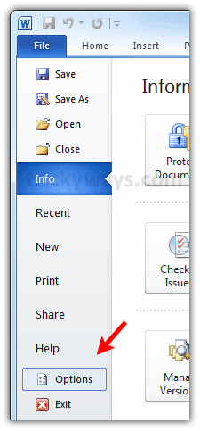
File Menu
Save : Ctrl + S = To save Our Documents
Save as : F12 = To make Same document in another name
Open : Ctrl + O = To open Save file / Doc
New : Ctrl + N = To take New Page
Print : Ctrl + P = To Print Documents
Print Preview = Before print check once as final copy

Slide 22
Simple Calculations
 | A | B | C | D | E | F
 |  |  | Addition | Sub | Mul | Div
1 | First Number | 8 | =B1+B2 | =B1-B2 | =B1*B2 | =B1/B2
2 | Second Number | 6
3
4 | First Number | 7 | =B4+B5 | =B4-B5 | =B4*B5 | =B4/B5
5 | Second Number | 6

Slide 23
Functional & Conditional Formula
If
Yes/ No
Datedif
Sumif
Countif
Min
Max
Min
Average
Sum
Date - Ctr + Shif + ;
Time - Ctr + ;

Slide 24
Eligible to Vote Or Not
 | A | B | C
1 | Name | Age | Condition
2 | AAA | 18 | =if(b2>=18,”Eligible”,”Not Eligible”)
3 | BBB | 15 | =if(b3>=18,”Eligible”,”Not Eligible”)

Slide 25
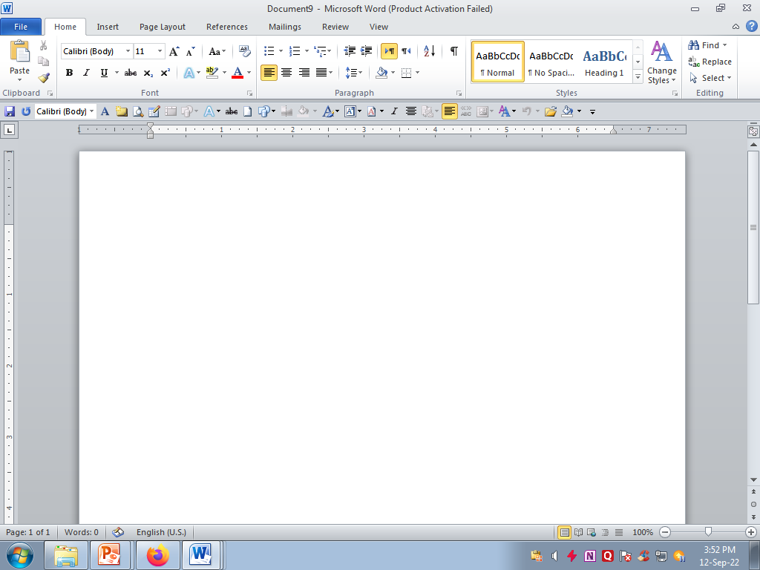
Home Tab
Clipboard | Font | Paragraph
CUT – Ctrl + X | Font Style [ Ctrl + Shift + F] | Bullets
Copy – Ctrl + C | Font Size -Ctrl + [ | Numbering
Paste – Ctrl + V | Increase Font - ctrl + shift + > | Line Spacing
 | Decrease Font - ctrl + shift + < | Indentation
 | Bold - Ctrl + B Italic - Ctrl + I Under Line - Ctrl + I Font Colour Change Case Clear Formatting Strikethrough highliter | Alignments Right - Ctrl + R Center - Ctrl + E Left - Ctrl + L Justify - Ctrl + J Paragraph

Slide 26
Insert Tab
Pivot table & Table 8. Hyperlink ( Ctrl + K) 15.Signature line
Picture 9. Bookmark 16. Date & Time
Clipart 10. Header & Footer 17.Objects
Shapes 11. Slicer 18. Equation
SmartArt 12. Text box
Chart 13. Word Art
Screenshot 14. Symbols

Slide 27
Page layout
* Themes * Page setup * Scale & Fit
Margins 9. Page color
Orientation 10. Page border
Size 11. Page number
Columns 12. Indent
Break 13. Spacing

